Slide 1





Budgeteers
INTELLIJ
JAVA
SQL
MOHAMED AYAZ - MEA24068
MUHAMMED SHAMIL TC - MEA24089
NAJIL A - MEA24095

Slide 2


Budgeteers
Abstract
Java-based application to record and manage daily expenses.
Built using OOP concepts and JDBC with MySQL.
Supports User Login, CRUD operations, and report generation.
Helps users track spending patterns and make better financial decisions.
MEA Engineering College, Perinthalmanna BTech Seminar Presentation 25-26 | Department of Computer Science & Engineering

Slide 3
Budgeteers
Introduction
Expense Tracker is a Java-based application to manage daily expenses.
Stores date, category, amount, and notes.
Provides a simple and efficient way to track and analyze spending.
Built using Object-Oriented Programming (OOP) and JDBC with MySQL
MEA Engineering College, Perinthalmanna BTech Seminar Presentation 25-26 | Department of Computer Science & Engineering

Slide 4
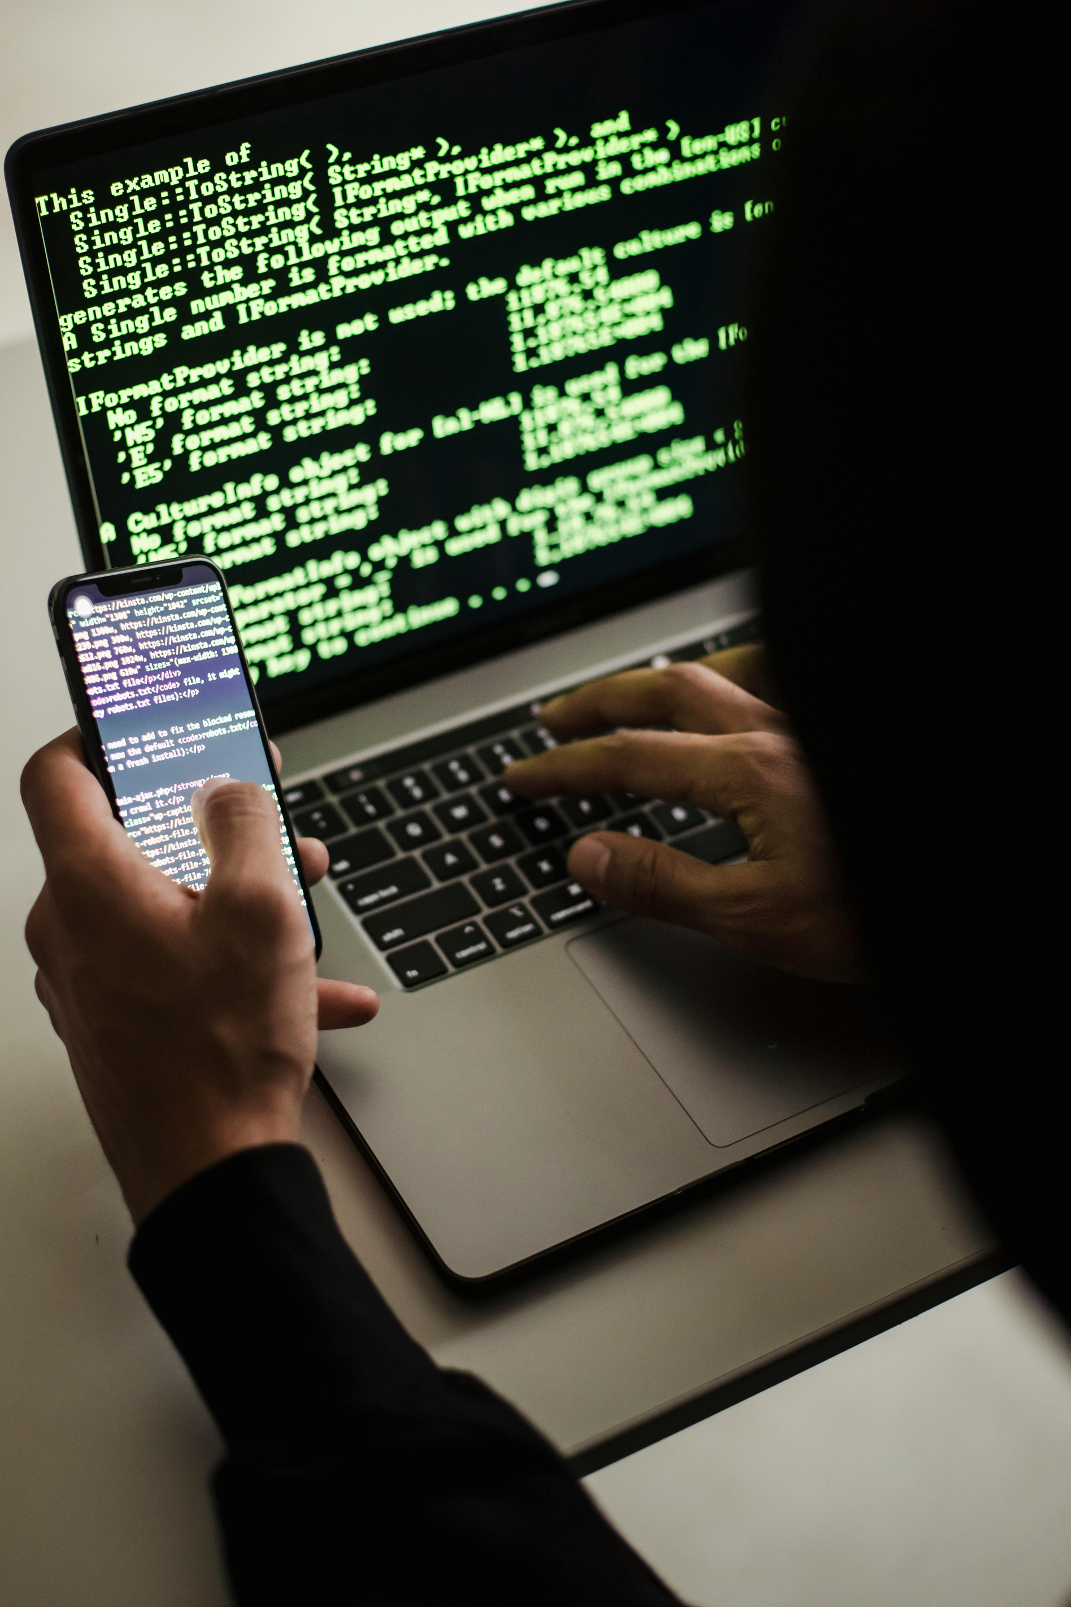
Budgeteers
Objectives
Automate expense recording.
Maintain expense history in a database.
Support add, update, delete, and view operations.
Generate reports by month or category.
Demonstrate OOP principles in Java.
MEA Engineering College, Perinthalmanna BTech Seminar Presentation 25-26 | Department of Computer Science & Engineering

Slide 5

Budgeteers
Problem Statement
Manual expense tracking is time-consuming and error-prone.
Difficult to analyze spending patterns.
No centralized system to manage expenses effectively.
Need for an automated solution to simplify personal finance management.
MEA Engineering College, Perinthalmanna BTech Seminar Presentation 25-26 | Department of Computer Science & Engineering

Slide 6
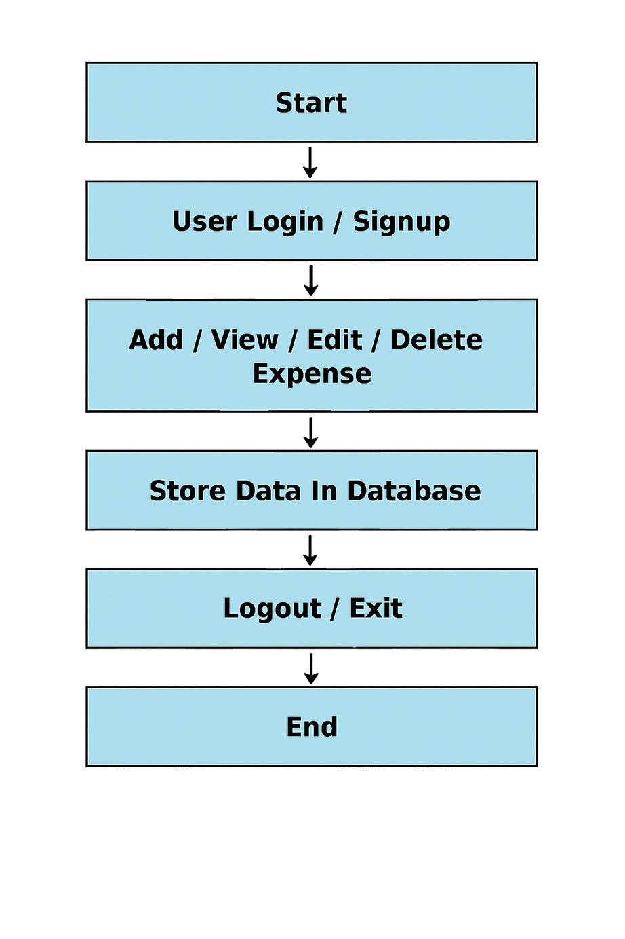
Budgeteers
Proposed Solution
GUI based Java application to manage expenses.
Users can Add, View, Update, Delete expenses, and generate reports.
Provides an automated way to track and analyze spending patterns.
Fig : Flowchart of Expense Tracker
MEA Engineering College, Perinthalmanna BTech Seminar Presentation 25-26 | Department of Computer Science & Engineering

Slide 7
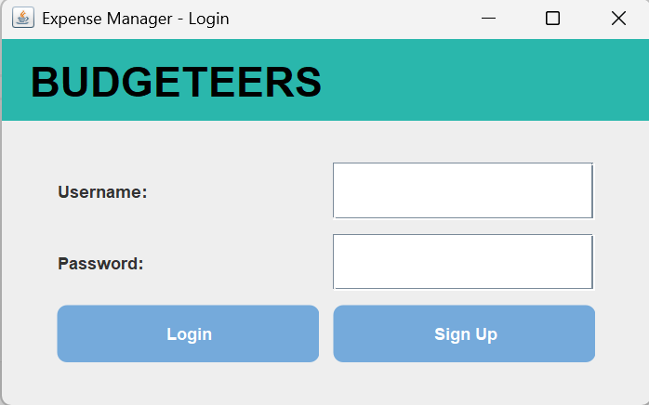
Budgeteers
Login Interface
MEA Engineering College, Perinthalmanna BTech Seminar Presentation 25-26 | Department of Computer Science & Engineering

Slide 8
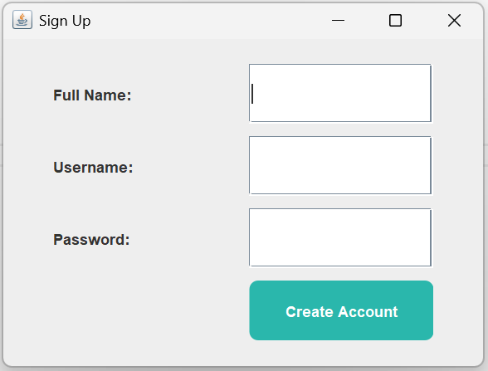
Budgeteers
Sign Up Interface
MEA Engineering College, Perinthalmanna BTech Seminar Presentation 25-26 | Department of Computer Science & Engineering

Slide 9
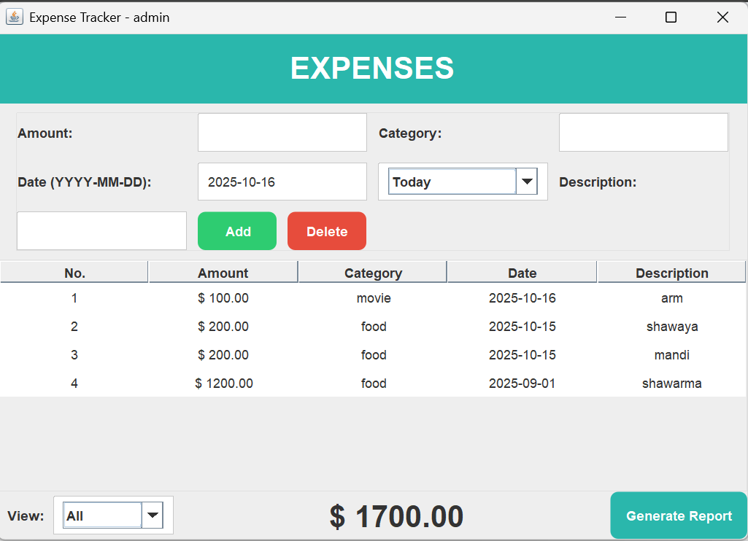
Budgeteers
Tracker Menu
MEA Engineering College, Perinthalmanna BTech Seminar Presentation 25-26 | Department of Computer Science & Engineering

Slide 10
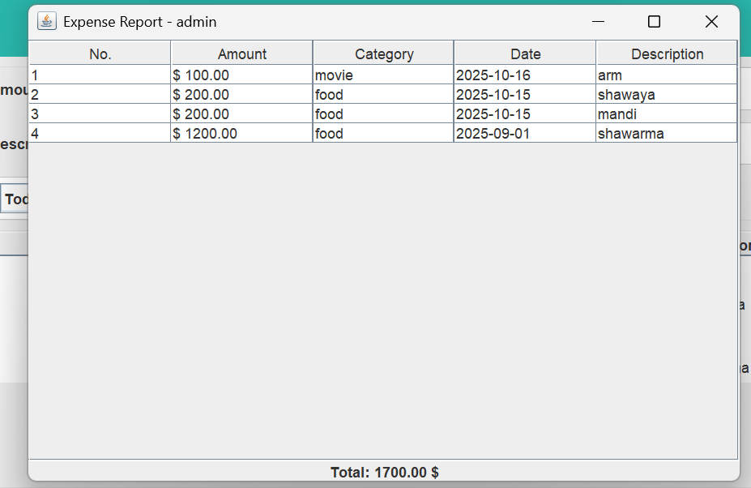
Budgeteers
Generated Report
MEA Engineering College, Perinthalmanna BTech Seminar Presentation 25-26 | Department of Computer Science & Engineering

Slide 11
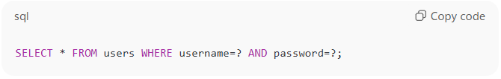
Budgeteers
User enters username and password in GUI.
GUI sends data to → AuthManager.login(username, password)
Java runs the SQL query →
4.If a matching record exists → login success ✅
5.Else → error message ❌
🧩 Flow of Login Process
MEA Engineering College, Perinthalmanna BTech Seminar Presentation 25-26 | Department of Computer Science & Engineering

Slide 12
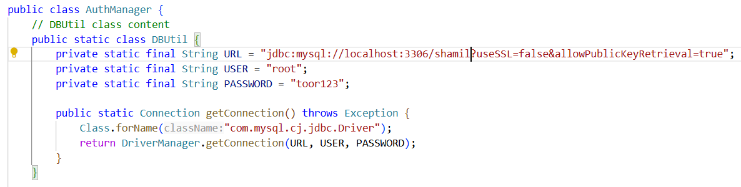
Budgeteers
⚙️ How Java Connects to This DB?
Through JDBC (Java Database Connectivity):
MEA Engineering College, Perinthalmanna BTech Seminar Presentation 25-26 | Department of Computer Science & Engineering

Slide 13
Budgeteers
Expense Tracker – Process Flow
User logs in
↓
TrackerFrame window opens
↓
User enters expense details → Clicks “Add” → INSERT query executes
↓
User clicks “View” → SELECT query fetches all rows → Displayed in JTable
↓
User updates or deletes records using buttons → UPDATE / DELETE queries execute
MEA Engineering College, Perinthalmanna BTech Seminar Presentation 25-26 | Department of Computer Science & Engineering

Slide 14
Budgeteers
Data Base Design
Field | Type | Description
id | INT (PK) | Unique ID (auto increment)
date | DATE | Expense date
category | VARCHAR | Food, Travel, Shopping etc
amount | DECIMAL | Expense amount
note | VARCHAR | Description/remark
MEA Engineering College, Perinthalmanna BTech Seminar Presentation 25-26 | Department of Computer Science & Engineering

Slide 15

Budgeteers
User Login → Secure authentication for individual users.
Add Expense → Store new entry.
View Expenses → List all records.
Update Expense → Modify existing details.
Delete Expense → Remove unwanted entries.
Features of Expense Tracker system
MEA Engineering College, Perinthalmanna BTech Seminar Presentation 25-26 | Department of Computer Science & Engineering

Slide 16

Budgeteers
Technology Used
Programming Language: Java
Database: MySQL (via JDBC)
IDE/Tools: IntelliJ & VS Code
Concepts Applied:
Object-Oriented Programming (OOP)
JDBC for database connectivity
MEA Engineering College, Perinthalmanna BTech Seminar Presentation 25-26 | Department of Computer Science & Engineering

Slide 17

Budgeteers
Conclusion
Budgeteers simplifies personal finance management.
Provides reliable storage and retrieval of expense records.
Demonstrates OOP + JDBC integration in Java.
MEA Engineering College, Perinthalmanna BTech Seminar Presentation 25-26 | Department of Computer Science & Engineering

Slide 18

Budgeteers
Reference
Java Documentation : docs.oracle.com
MySQL Documentation : dev.mysql.com
TutorialsPoint (Java & JDBC)
IDEs : VS Code & Intellij
AI-Tools : ChatGPT & Grok
MEA Engineering College, Perinthalmanna BTech Seminar Presentation 25-26 | Department of Computer Science & Engineering

Slide 19

Budgeteers

